Slide 1


Stock Price Forecasting
Daniel Journic

Slide 2
Introduction
This Presentation will cover:
The business problem
Data
Methods
Results

Slide 3

The problem
Retail investors account for up to 30% of trading volume

Slide 4
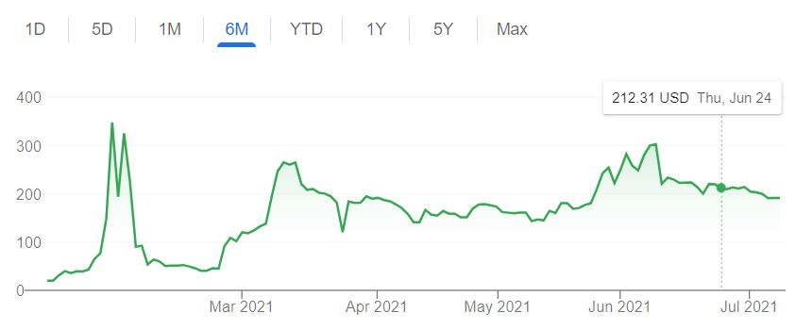
The Problem
So how can we give retail investors a simple, easy to understand way to choose stocks?

Slide 5
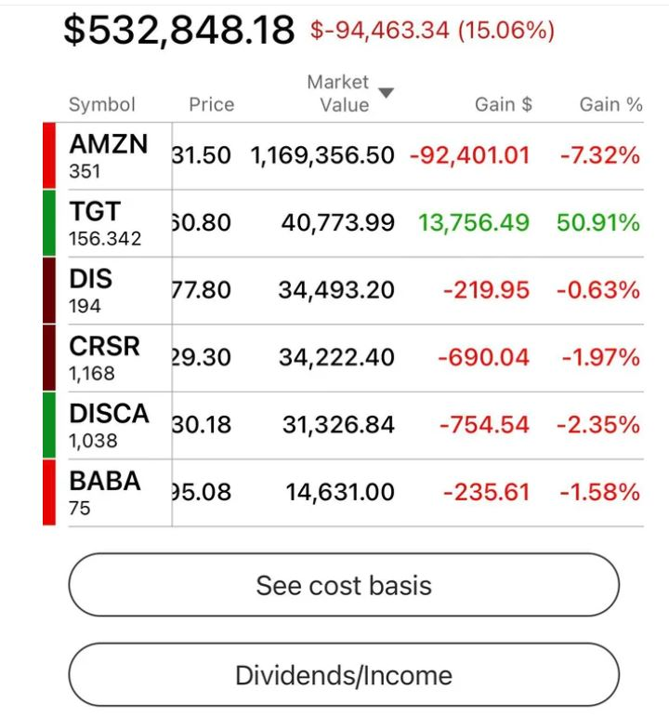
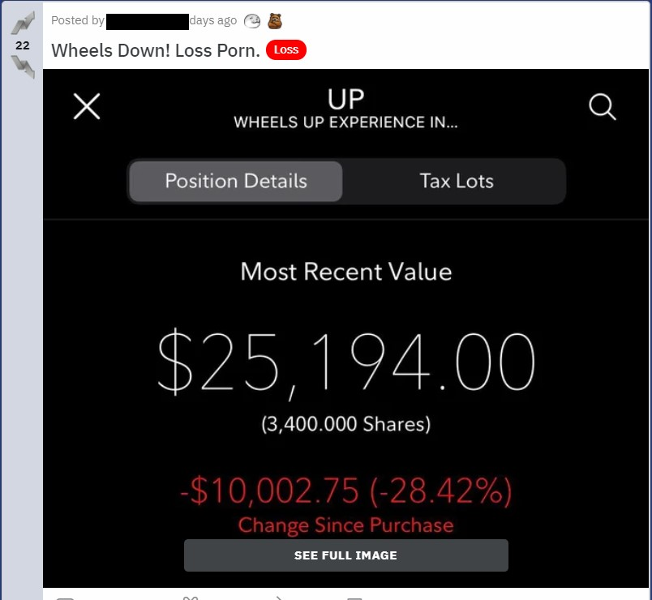
Who is the audience?

Slide 6
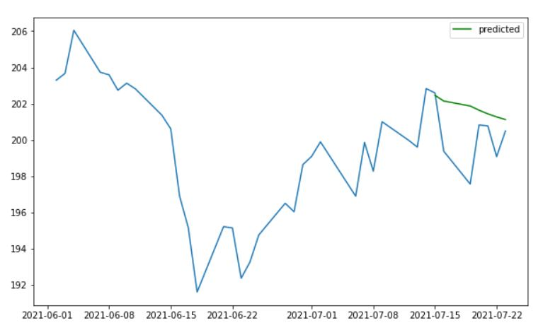
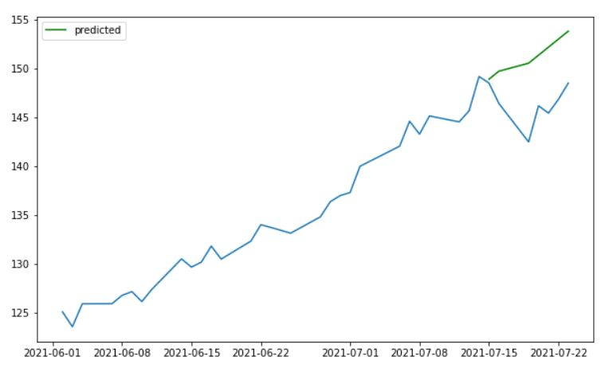
Forecasting with ARIMA
MMM
AAPL

Slide 7
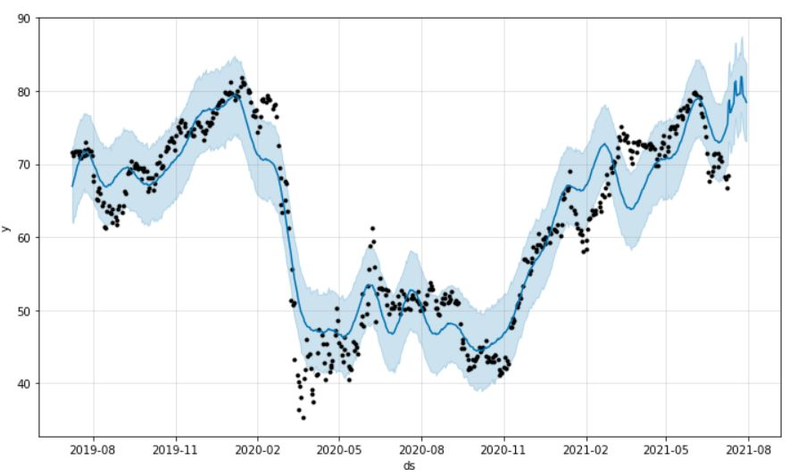
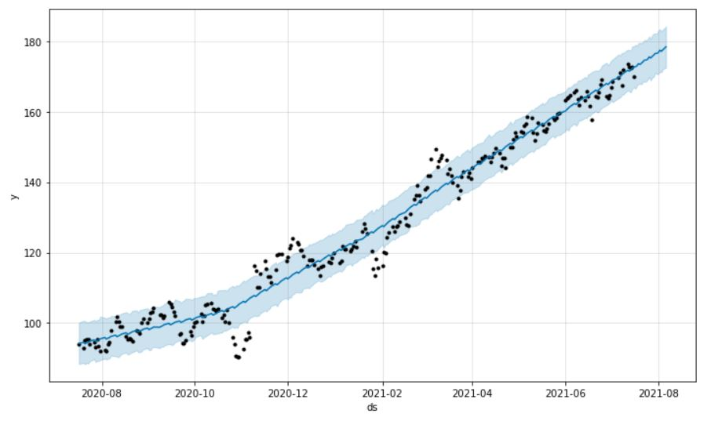
Prophet
MMM
AXP

Slide 8
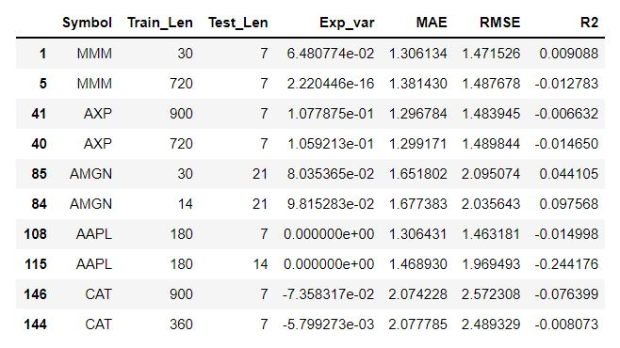
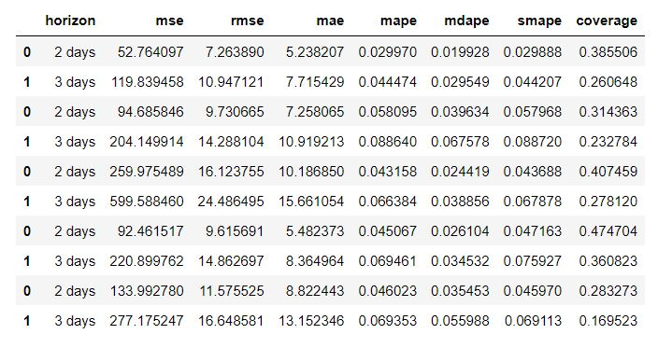
ARIMA vs Prophet

Slide 9
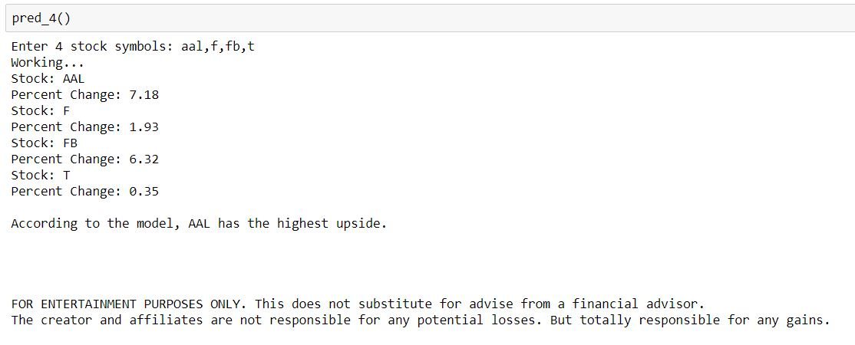
The Results

Slide 10
Conclusion/Further work
Prophet is the way to go
FLASH---SPARKLE!!!

Slide 11
Thank you! Questions?
djournic@gmail.com

